Slide 1
LIBRARY INTELLIGENT BOOK RECOMMENDATION SYSTEM USING FACIAL EXPRESSION RECOGNITION
DEVIKA.PS
MES20MCA-2016
Product Owner:MR.GEEVER C.ZACHARIAS

Slide 2
Table of contents
Abstract
Modules
Developing Environment
Data Flow Diagram
Product Backlog
User Story
Project Plan
Sprint Plan

Slide 3
Abstract
This system recommends books based on user preferences. Before performing user facial expression recognition, standardized pre-processing of the acquired facial image data is required. Pre-processing includes image cropping, gray-scale processing, normalization processing,equalization processing,etc.Face detection is performed on the input image through the OpenCV built-in algorithm. Convolutional neural networks can quickly locate and segment facial images,and then learn and sample facial expression features in facial images. The neural network model classifies facial expressions of the input face image based on the learned features.The system selects the maximum probability value among different expressions as the output value. When the output value is "happy" or "surprised",it is judged that the user has a good impression of the type of book currently being browsed. Finally, recommendations are made based on the type of book the user likes.

Slide 4
Modules
Librarian
Librarian can login the app using his/her unique username and password. They can view rules and notification. The Librarian has the ability to add books and also he/she can view and manage the book .list. They can add the summary list of each book uploaded
Login
Add and manage books
Approve users
View book reservation
Issue book
Return book

Slide 5
User
User must register before login. User can login the app using his/her unique username and password. User can view books and buy it.
Registration
View Books
Reserve a book
Return book
Recommendation
Emotion Detection Module
Emotion is one of the very few words in the English language that do not have a concrete definition and it is understandable. It is abstract. Yet, almost every decision we have ever made in our lives is driven by emotion. Marketing research has proven that predicting sentiments correctly can be a huge source of growth for businesses and that’s what we will be working on today — Reading Emotions.Expressions on the face are a vital mode of communication in humans as well as animals. Human behavior, psychological traits, are all easily studied using facial expressions. It is also widely used in medical treatments and therapies.The Face Emotion Recognizer (generally knowns as the FER) is an open-source Python library built and is used for sentiment analysis of images and videos.The project is built on a version that uses a convolution neural network with weights mentioned in the HDF5 data file present in the source code.
The flow of Logic: The program starts by taking into input the image or video that needs analysis. The FER() constructor is initialized by giving it a face detection classifier (Open CV Haarcascade ). We then call this constructor’s detect emotions function by passing the input object (image or video) to it. The result achieved is an array of emotions with a value mentioned against each. Finally, the ‘top_emotion’ function can seclude the highest valued emotion of the object and return it.

Slide 6
Developing Environment
HARDWARE REQUIREMENTS
Processor : Intel Pentium Core i3 and above
PrimaryMemory : 4GB RAM and above
Storage : 320 GB hard disk and above
Display : VGA Color Monitor
KeyBoard : Windows compatible
Mouse : Windows compatible

Slide 7
SOFTWARE REQUIREMENTS
One of the most difficult task is selecting software for the system, once the system requirements is found out then we have to determine whether a particular software package fits for those system requirements. The application requirement:
Frontend : Html, CSS,Javascript
Backend : MySQL
Operatingsystem : windows 7 orabove
Technology Used : Python
IDE : Pycharm,Android Studio
Frame Work Used : Flask

Slide 8
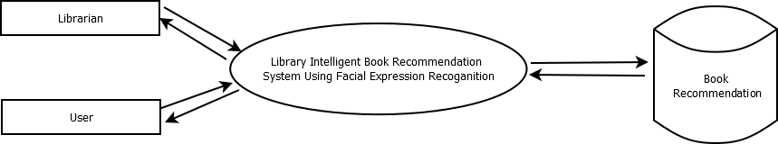
Data Flow Diagram
Level 0

Slide 9
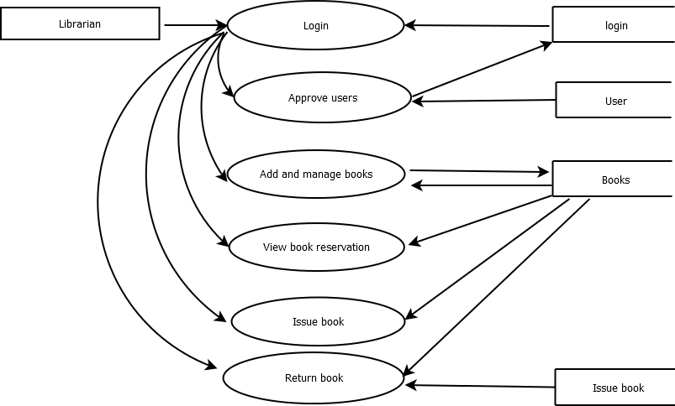
Level 1.1

Slide 10
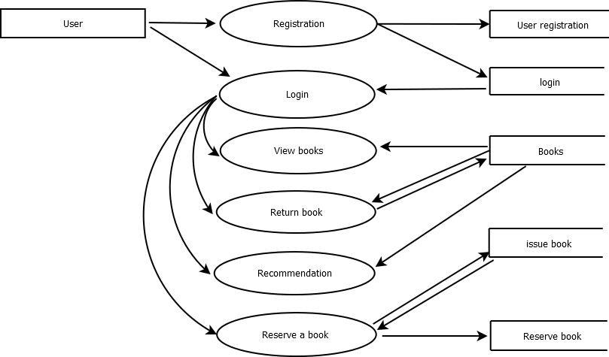
Level 1.2

Slide 11
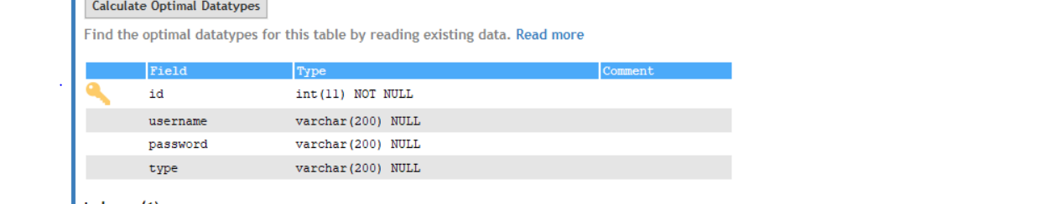
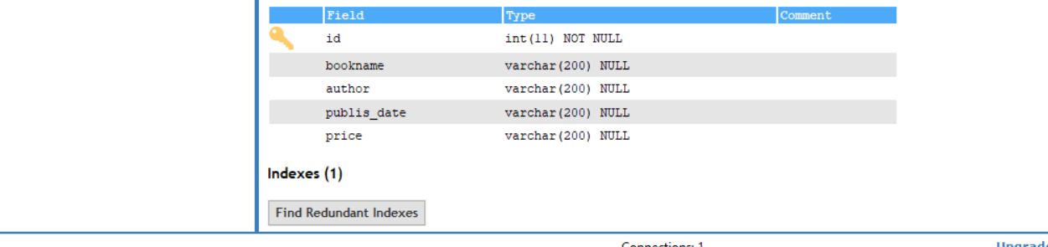
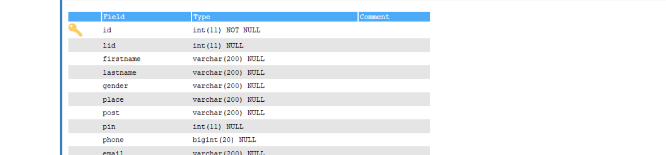
Table Design

Slide 12
User Story ID | Priority <High/Medium/Low> | Size (Hours) | Sprint <#> | Status <Planned/In progress/Completed> | Release Date | Release Goal
1 | Medium | 2 | 1 | Completed |  | Table design
2 | High | 3 |  | Completed |  | Form design
3 | High | 5 |  | Completed |  | Basic coding
3 | High | 5 | 2 | Planned |  | Preprocessing of image data
4 | Medium | 5 |  | Planned |  | Facial detection from preprocessed data
5 | High | 5 | 3 | Planned |  | Training the data
6 | medium | 5 |  | Planned |  | Modeling the data
7 | Medium | 5 | 4 | Planned |  | Testing data
8 | High | 5 |  | Planned |  | Output generation
Product backlog

Slide 13
UserStoryID | As a <type of user> | I want to | So that I can
1 | Admin | login | login successful with correct username and password
2 | Admin | Add & Manage Books | can insert,view& delete books
3 | Admin | Approve users | registered users must be approved by admin
User Story

Slide 14
User Stor y ID | Task Name | Start Date | End Date | Days | Status
1 | Sprint 1 | 27-12-2021 | 27-12-2021 | 4 | Completed
2 |  | 28-12-2021 | 28-12-2021 |  | Completed
3 | Sprint 2 | 29-12-2021 | 29-12-2021 | 4 | Planned
4 |  | 15-01-2022 | 16-01-2022 |  | Planned
5 | Sprint 3 | 22-01-2022 | 22-01-2022 | 8 | Planned
6 |  | 23-01-2022 | 23-01-2022 |  | Planned
7 | Sprint 4 | 05-02-2022 | 06-02-2022 | 4 | Planned
8 |  | 12-02-2022 | 12-02-2022 |  | Planned
Project Plan

Slide 15
Sprint Plan

Slide 16
Backlog item | Status & Completion date | Original Estimate in hours | Day 1 | Day 2 | Day 3 | Day 4 | Day 5 | Day 6 | Day 7 | Day 8 | Day 9 | Day 10 | Day 11 | Day 12
User Story#1,2 |  |  | Hours | Hours | Hours | Hours | Hours | Hours | Hours | Hours | Hour s | Hours | Hours | Hours
Table design | 27/12/2021 | 5 | 5 | 0 | 0 | 0 | 0 | 0 | 0 | 0 | 0 | 0 | 0 | 0
Form design | 28/12/2021
 |  | 5 | 0 | 5 | 0 | 0 | 0 | 0 | 0 | 0 | 0 | 0 | 0 | 0
User story #3,4
Basic coding &
Facial recognition | 23/01/2022
User story #5,6
Emotion recognition & Sentiment analysis | 29/01/2022
User story #7,8
Testing & Output | 12/02/2022
Total |  | 50 | 5 | 5
Sprint Actual

Slide 17
THANK YOU

